Slide 1



UNIT 2: Home is where heart is
I live at school

Slide 2
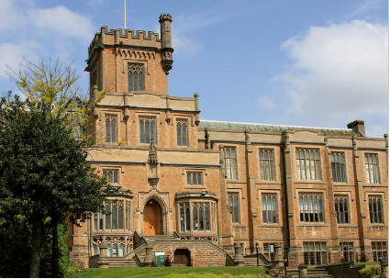
Would you like to live at school? Why? Why not?
Do you know anyone who lives at school?
Do you think living at school is fun?

Slide 3
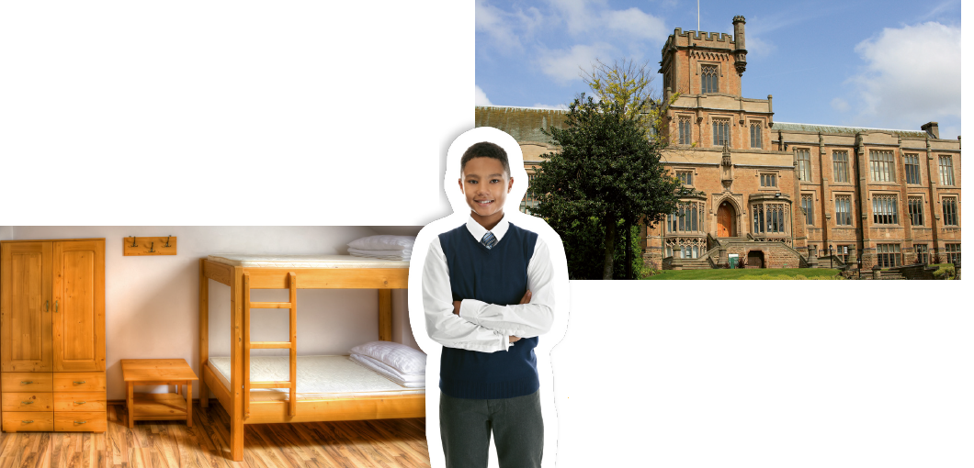
What does the boy in the photo look like?
Do you think he’s happy?

Slide 4
Translate.
boarding school –
bunk bed –
all-boys school –
ground floor –
nurse –
a roommate –
common room –
a school where students have lessons, but where they also live and sleep. - internat
krevet na kat
school for boys only (škola koju pohađaju isključivo dječaci)
prizemlje
medicinska sestra
osoba koja dijeli sobu s tobom, cimer/ica
zajednička soba

Slide 5
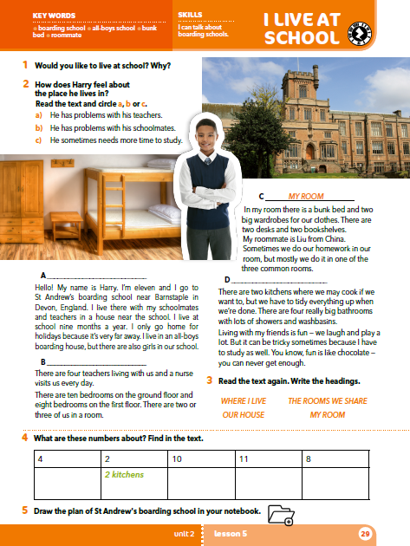
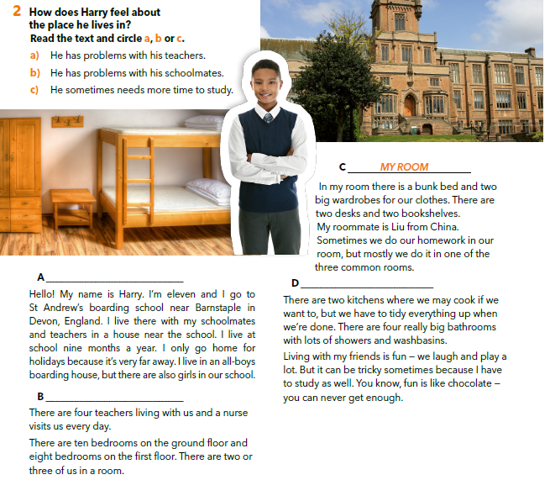
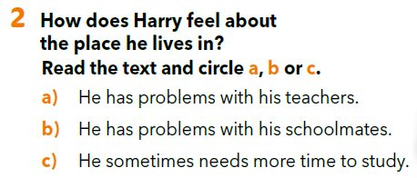

Slide 6
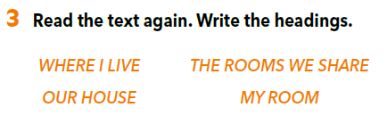
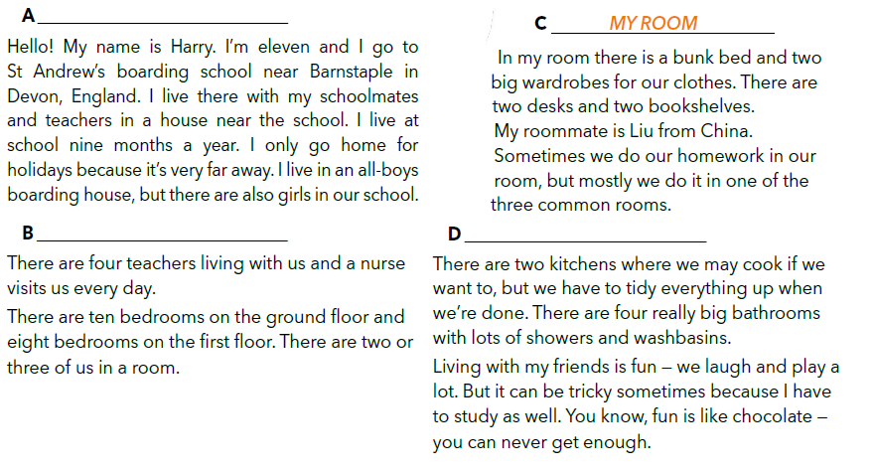
Read the text again and write the correct heading.
WHERE I LIVE?
OUR HOUSE
THE ROOMS WE SHARE

Slide 7
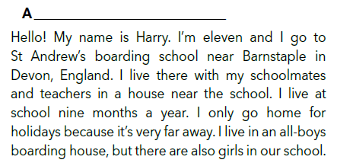
Where is Harry’s school?
WHERE I LIVE?
Who lives with him and his mates?
Is his home near?
Are there girls in his school?
What about his boarding house?

Slide 8
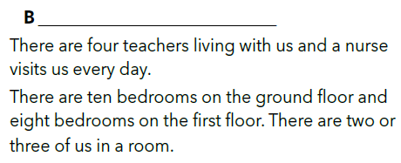
Answer the following questions.
OUR HOUSE
Who visits them every day?
How many floors are there?

Slide 9
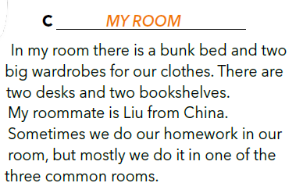
What’s his roommate’s name?
Where is he from?
Where do they do their homework?

Slide 10
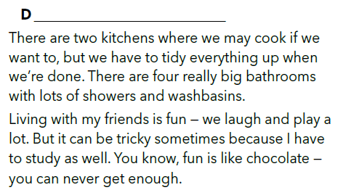
THE ROOMS WE SHARE
Can they cook in their boarding house?
What do they have to do after cooking?
Why is living with friends tricky?

Slide 11
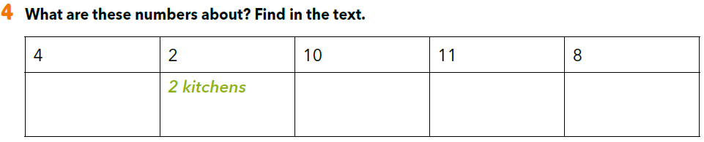
10 bedrooms on the ground floor
4 teachers
11 years old
8 bedrooms on the first floor

Slide 12
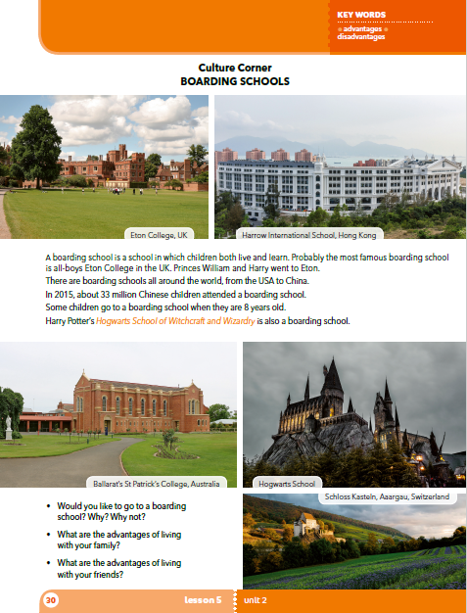
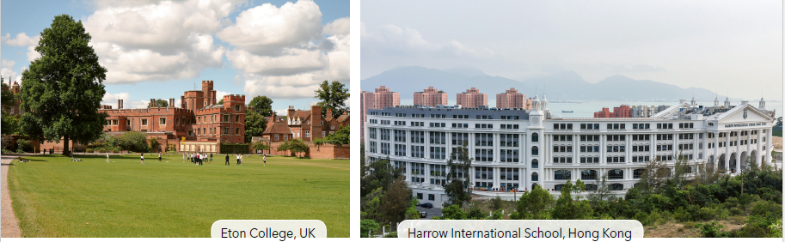

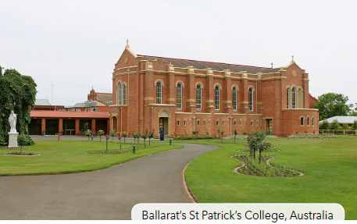
Which school is your favourite?
What do you know about Hogwarts?
Which ‘”houses” are there in Hogwarts?
Gryffindor
Hufflepuff,
Ravenclaw
Slytherin

Slide 13
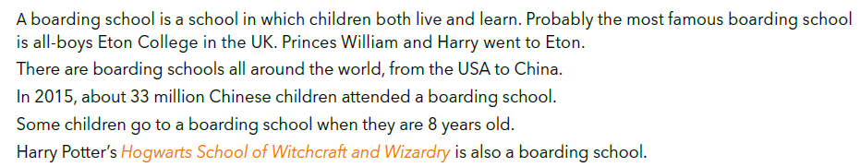
Read the text on page 30 and answer the questions.
Which two Eton students are very important in the UK?
How many students attend boarding schools in China?

Slide 14
FIND ONLINE
Choose one of the five schools.
Find answers to the following questions online.
How old is the school?
How old are the students?
Are there boys and girls?
What can students do in their free time?

Slide 15
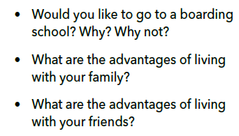
Look at the questions from task 3 and discuss.

Slide 16
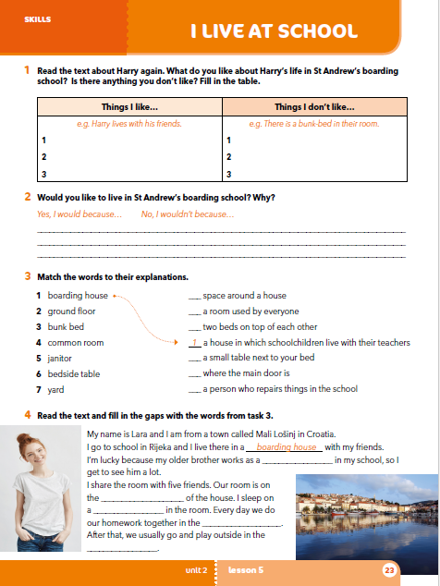
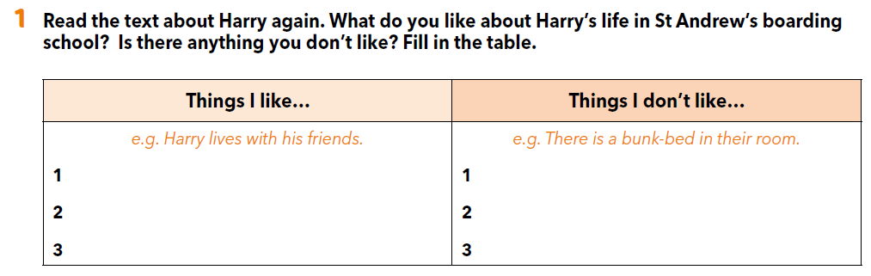
Workbook p 23.

Slide 17
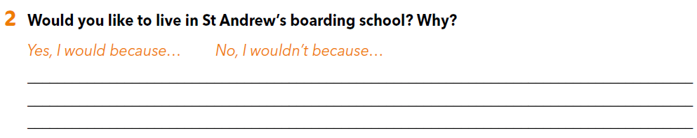

Slide 18
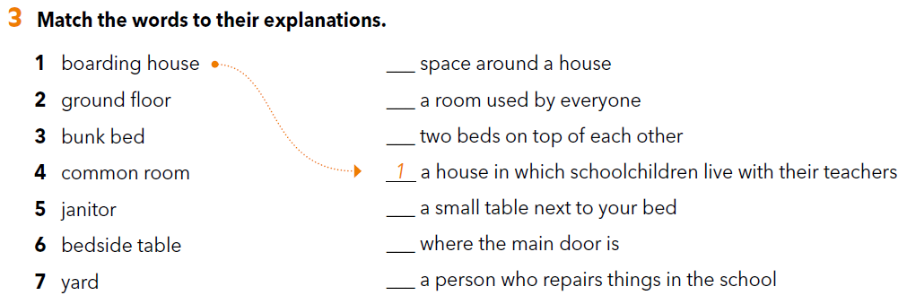
7
4
3
6
2
5

Slide 19
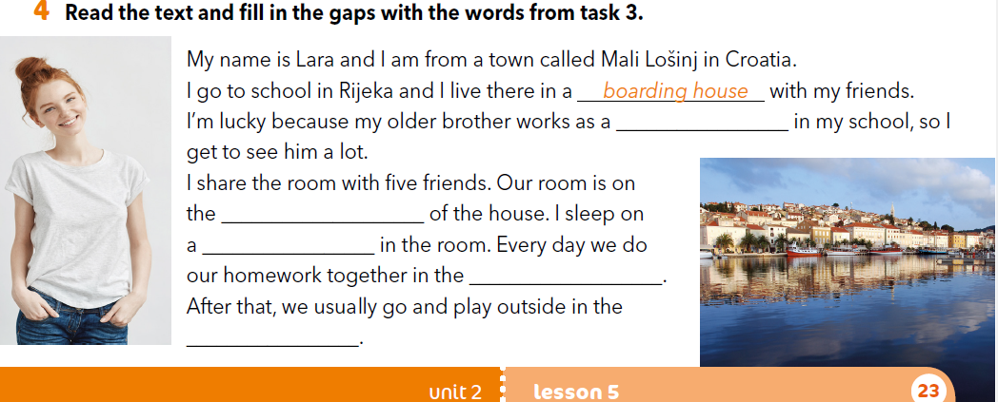
janitor
ground floor
bunk bed
common room
yard

Slide 20

LEARN MORE.
https://www.e-sfera.hr/dodatni-digitalni-sadrzaji/232891e1-91b4-43f3-b042-67523c52a119/
An Upside Down House
Read the text. Imagine a strange house on your own. Draw a sketch and explain by answering the questions below the text.

